Slide 1


Slide 2

Notes:
We believe that everyone deserves a high quality park, but a large swath of the US population– one in three Americans– does not have a park within a 10-minute walk of home.
We want to change that.

Slide 3
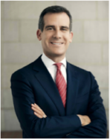
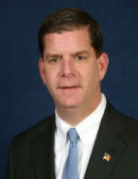
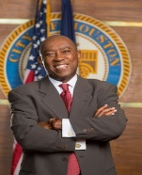
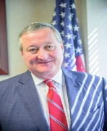
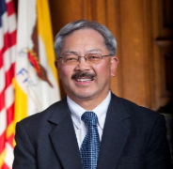
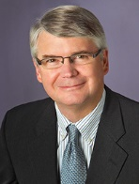
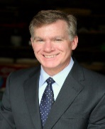
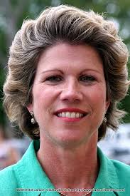
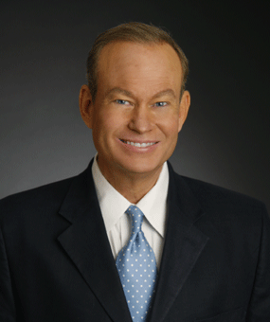
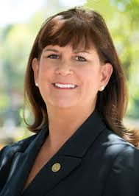
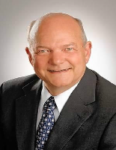
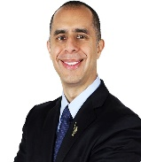
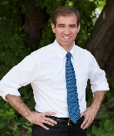
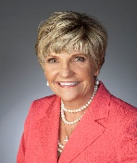
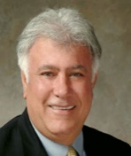

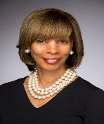
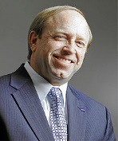
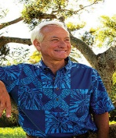
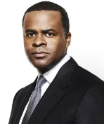
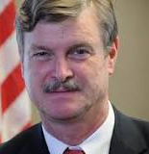
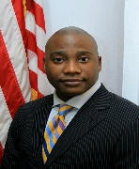
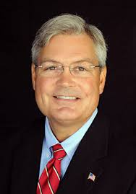
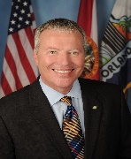
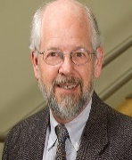
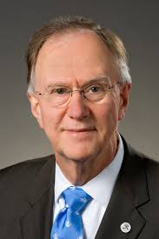
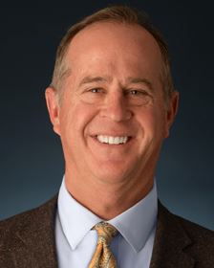
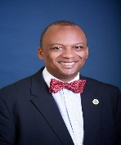
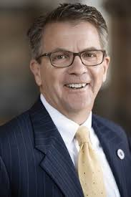

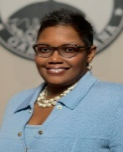
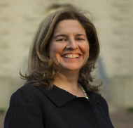
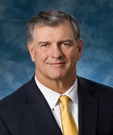
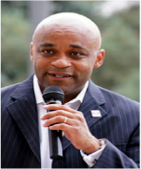
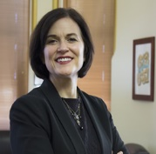
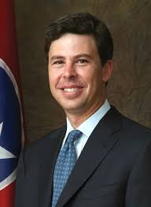
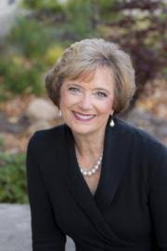
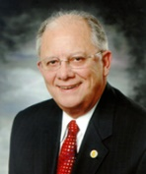
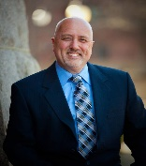
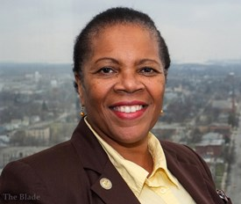
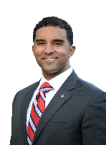
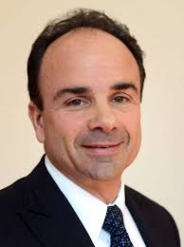
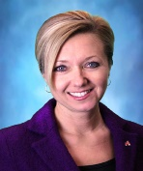
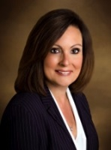
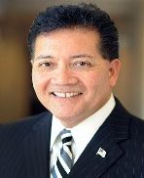
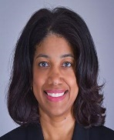
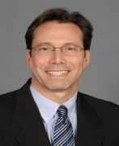
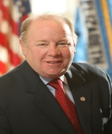
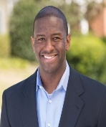
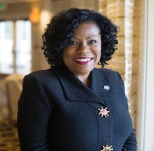
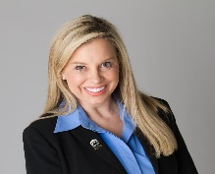
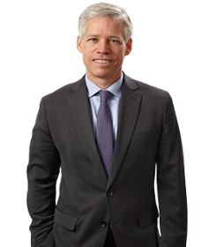




























































More than 200 mayors from across the country.

Slide 4
10 lessons from
WINNING
and
LOSING
on ballots all across America.

Slide 5
Mayors can be helpful…most of the time.

Slide 6
….most of the time.

Slide 7
New tools are available to understand and reach voters like never before.
Notes:
Emerging technologies allow you to directly engage with potential supporters and influencers who affect an advocacy campaign’s outcome. By using social listening technologies, which track conversations around specific phrases, an organization can quickly glean who’s talking online about an issue, what they’re saying, and how opponents are messaging on the other side.
In real time and for little money, apps can pull data from Facebook, Twitter, and Instagram and generate listening reports, which can reveal opportunities to create messaging for influencers and winnable audiences.
Other technologies in online polling allow an organization to test, in real time and at a fraction of the cost of traditional polling, whether a message is resonating.
Using this research, you can target compelling messages to specific zip codes, city blocks, or even individual buildings.

Slide 8
Find and use the winning message right from the start.
Messengers really matter.

Slide 9
Voters aren’t dumb.

Slide 10

Kitchen table math really matters to voters.

Slide 11
Unconventional allies can transform a campaign.

Slide 12

Do opposition research.
Notes:
If you don’t think that you have opponents, think again. Newton’s third law of motion—for every action, there is an equal and opposite reaction—applies as much to the physics of ballot fights as it does to the properties of matter and energy.
For example, we were working with the nonprofit Autism Speaks who had every reason to believe that a bill it was supporting in North Carolina would win approval in the state’s General Assembly. After all, it aimed to require certain health plans to cover an effective treatment for helping kids with autism. Conventional wisdom held that few elected officials would turn their backs on autistic kids. In fact, the proposed legislation seemed to have broad bipartisan support.
We were wrong.
When we dug deep into publicly available lobbying disclosure reports, we found Blue Cross Blue Shield of North Carolina had spent more than $485,000 on lobbying the state government against our bill.
Having confirmed that large insurance companies were likely responsible for helping to stall autism legislation, Autism Speaks could then mount a two-pronged counteroffensive. To win over elected officials, the organization commissioned a statewide poll, which found that 82 percent of North Carolina voters supported autism insurance reform. The organization then developed a messaging campaign highlighting fiscally conservative reasons for the Republican- controlled legislature to support the bill. At the same time, Autism Speaks launched an ad campaign that directly took on “Big Insurance” in North Carolina.
Eventually Blue Cross dropped their opposition and the bill was approved by the General Assembly.

Slide 13


You need thick skin and resilience in political campaigns.
Notes:
I spent more than a decade working in the marriage equality movement.
We went through many, many, many painful losses, including Prop 8 in 2008, before the Supreme Court ruled in 2015.
In park funding, you also see this resilience.
In Los Angeles, the city had a very public failure when a county wide parcel tax focused on funding parks and conservation measures failed in 2014 by not reaching the 75% support needed (63% voted yes). The parks and recreation team regrouped, conducted a more thorough assessment of what the county needed, and came back two years later and voters approved Measure A with 75% voting yes.

Slide 14
The campaign is won or lost before the campaign launches publicly.

Slide 15
GO WIN!

